Slide 1
Discrete Probability Distributions
Instructor
Osama Bin Ajaz
Lecturer, S & H Dept.,
FAST-NU, Main Campus, Karachi
osama.ajaz@nu.edu.pk

Slide 2
The Bernoulli Process
1. The experiment consists of repeated trials.
2. Each trial results in an outcome that may be classified as a success or failure.
3. The probability of success, denoted by p, remains constant from trial to trial.
4. The repeated trials are independent.
Notes:
Examples: Tossing a coin, Defective or Non defective, Pass/fail

Slide 3

Binomial Distribution
The number X of successes in n Bernoulli trials is called a binomial random variable.
The probability distribution of this discrete random variable is called the binomial distribution.
The probability of a success in a binomial experiment can be computed with this formula:

Slide 4
Examples 01 – 03
A coin is tossed 3 times. Find the probability of getting exactly two heads.
The probability that a certain kind of component will survive a shock test is 3/4. Find the probability that exactly 2 of the next 4 components tested survive.
The probability that a patient recovers from a rare blood disease is 0.4. If 15 people are known to have contracted this disease, what is the probability that
(a) at least 10 survive,
(b) from 3 to 8 survive, and
(c) exactly 5 survive?
Notes:
(1) 3/8 = 0.375
2) N=4, p = ¾, x = 2 P(x=2) = 27/128
(3) P(X>10)=0.0338 P(3 to 8) = 0.8779 P(X = 5) = 0.1859

Slide 5
Example # 04
A large chain retailer purchases a certain kind of electronic device from a manufacturer. The manufacturer indicates that the defective rate of the device is 3% .
(a) The inspector randomly picks 20 items from a shipment. What is the probability that there will be at least one defective item among these 20?
(b) Suppose that the retailer receives 10 shipments in a month and the inspector randomly tests 20 devices per shipment. What is the probability that there will be exactly 3 shipments each containing at least one defective device among the 20 that are selected and tested from the shipment?
Notes:
P(X>=1) = 1 – p(x=0) = 0.4562.
P = 0.4562 P(Y=3) = 0.1602

Slide 6
Example # 05 – 07
A coin is tossed 4 times. Find the mean, variance, and standard deviation of the number of heads that will be obtained.
Solve the above problem using the concept of expected values.
A die is rolled 480 times. Find the mean, variance, and standard deviation of the number of 3s that will be rolled.
Notes:
Mean = 2, var = 1
# Heads = X = (0, 1/16) (1, 4/16) (2, 6/16) (4/16) (1/16) E(x) = 2 =mean
(7) Mean = n p = 480(1/6) = 80 & sigma = 8.16

Slide 7
Multinomial Experiments
Each trial in an experiment has more than two outcomes.
the probabilities for each trial remain constant.
the outcomes are independent for a fixed number of trials.
Events must also be mutually exclusive.

Slide 8
Examples of Multinomial Experiments
52 playing cards.
Rolling a dice.
a survey might require the responses of “approve,” “disapprove,” or “no opinion.”

Slide 9
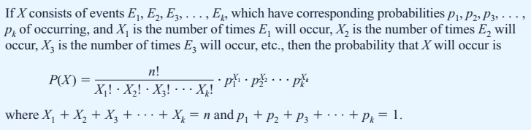
Multinomial Distribution

Slide 10
Example # 08: Leisure Activity
In a large city, 50% of the people choose a movie, 30% choose dinner and a play, and 20% choose shopping as a leisure activity. If a sample of 5 people is randomly selected, find the probability that 3 are planning to go to a movie, 1 to a play, and 1 to a shopping mall.
Notes:
P(X) = 0.15

Slide 11
Example # 09: Coffee Shop Customers
A small airport coffee shop manager found that the probabilities a customer buys 0, 1, 2, or 3 cups of coffee are 0.3, 0.5, 0.15, and 0.05, respectively. If 8 customers enter the shop, find the probability that 2 will purchase something other than coffee, 4 will purchase 1 cup of coffee, 1 will purchase 2 cups, and 1 will purchase 3 cups.
Notes:
N=8, P(X) = 0.0354

Slide 12
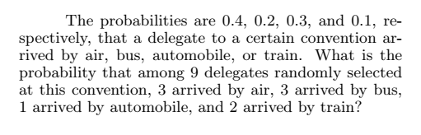
Example # 10: Arrival of delegation
Notes:
9c(3,3,1,2) = 0.0077.

Slide 13
Hypergeometric Experiment
The result of each trial can be classified as Success or Failure.
The probability of success changes on each trial.
Successive trials are dependent.
The experiment is repeated a fixed number of times.

Slide 14
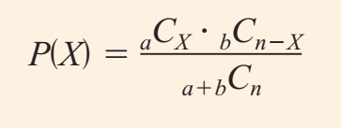
Hypergeometric Distribution
Given a population with only two types of objects (Success or failure), such that there are a items of one kind and b items of another kind and a b equals the total population, the probability P(X) of selecting without replacement a sample of size n with X items of type a and (n - X) items of type b is:

Slide 15
Example # 11 – 13
Assistant Manager Applicants: Ten people apply for a job as assistant manager of a restaurant. Five have completed college and five have not. If the manager selects 3 applicants at random, find the probability that all 3 are college graduates.
House Insurance: A recent study found that 2 out of every 10 houses in a neighborhood have no insurance. If 5 houses are selected from 10 houses, find the probability that exactly 1 will be uninsured.
Defective Compressor Tanks: A lot of 12 compressor tanks is checked to see whether there are any defective tanks. Three tanks are checked for leaks. If 1 or more of the 3 is defective, the lot is rejected. Find the probability that the lot will be rejected if there are actually 3 defective tanks in the lot.
Notes:
(11) 1/12
(12) 5/9
(13) 0.38 = 1(84)/220 and P(at least one defective = 1 – 0.38 = 0.618

